Slide 1
AWS IAM (Identity and Access Management)
Securing AWS Resources with Roles, Policies, and Permissions

Slide 2
Objectives
Understand the purpose of IAM in AWS
Learn key IAM components: Users, Groups, Roles, and Policies
Explore IAM security best practices
Hands-on: Creating and managing IAM entities

Slide 3
What is IAM?
Definition: IAM allows secure management of access to AWS services and resources
Key Features:
Manage users and their access
Granular permissions
Identity federation for external access
Free service (pay only for used AWS resources)

Slide 4
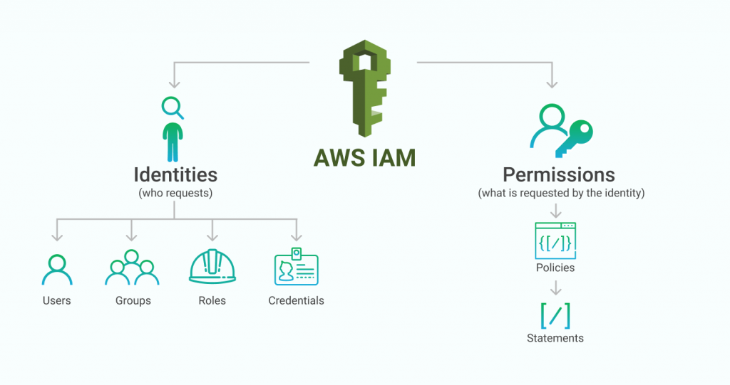
Key IAM Concepts
Users: Individual identities with credentials to access AWS
Groups: Collections of users sharing the same permissions
Roles: Temporary access to AWS resources, used by applications or services
Policies: JSON documents defining permissions

Slide 5
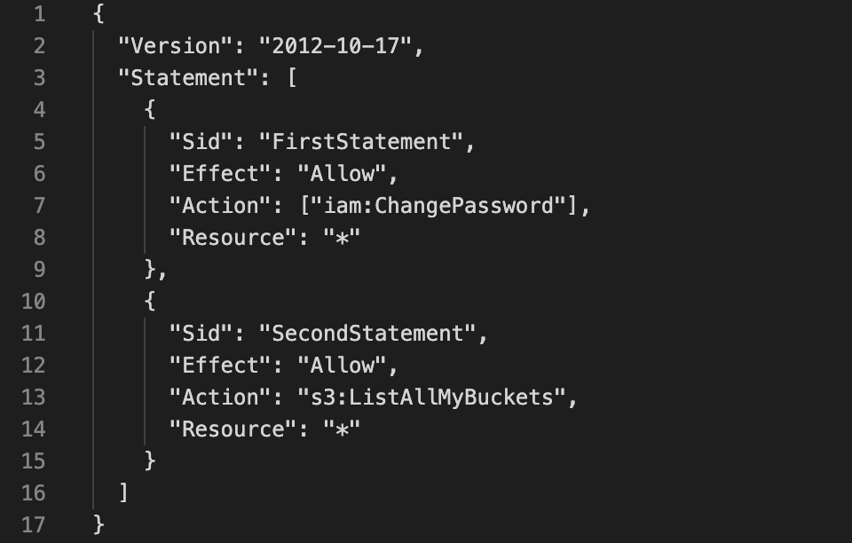
IAM Policies Explained
Types of Policies:
AWS Managed Policies (predefined)
Customer Managed Policies (customizable)
Inline Policies (attached directly to an entity)
Structure:
Actions: What can be done (e.g., s3:ListBucket)
Resources: Where the action is applied (e.g., arn:aws:s3:::bucket-name)
Effect: Allow or Deny

Slide 6
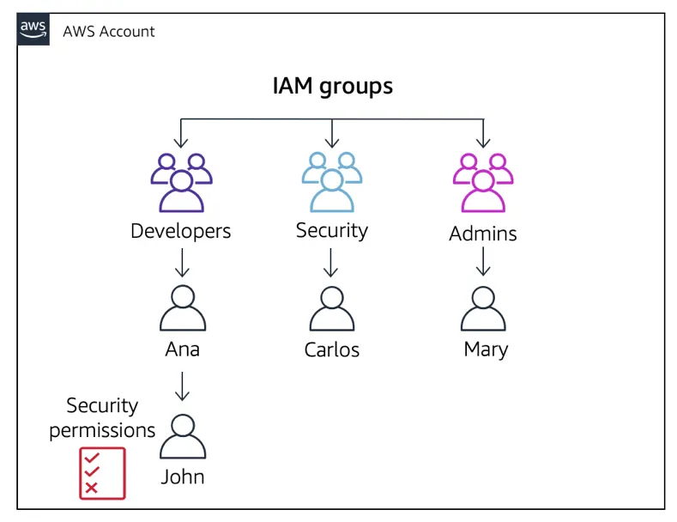
IAM Components Relationship
Diagram showing how users, groups, roles, and policies interact:
Users belong to groups
Groups have attached policies
Roles are assumed by users or AWS services

Slide 7
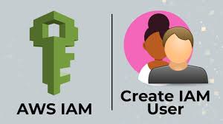
Hands-On: Creating an IAM User
Objective: Create a user with specific permissions
Steps:
Go to the IAM Dashboard
Click "Add User"
Assign access type (console or programmatic)
Attach a policy (e.g., AmazonS3ReadOnlyAccess)
Download the access credentials

Slide 8
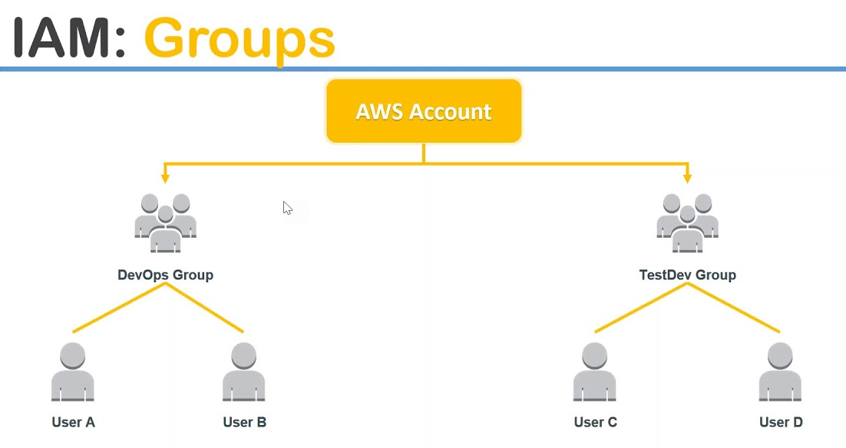
Hands-On: Creating a Group
Objective: Create a group with shared permissions
Steps:
Create a group in IAM
Attach a policy (e.g., AmazonEC2FullAccess)
Add users to the group

Slide 9
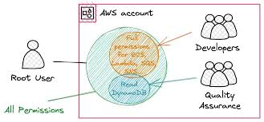
Hands-On: Creating a Role
Objective: Grant temporary access to a service (e.g., EC2 accessing S3)
Steps:
Create a role in IAM
Select a use case (e.g., AWS Service > EC2)
Attach a policy (e.g., AmazonS3FullAccess)
Assign the role to an EC2 instance

Slide 10
IAM Security Best Practices
Enable Multi-Factor Authentication (MFA)
Follow the principle of least privilege
Rotate access keys regularly
Use IAM roles instead of sharing credentials
Monitor activity with CloudTrail

Slide 11
Real-World Use Cases
Developers: Programmatic access to deploy applications
Administrators: Manage accounts, services, and users
Applications: Access S3, DynamoDB, or other resources using roles

Slide 12
Summary
IAM is essential for securing AWS resources
Key components: Users, Groups, Roles, and Policies
Always implement security best practices

